Slide 1
Predicting Marketing Response
ML Portfolio
Timur Yesmukhan

Slide 2
Content
Industry Research
4 slides
Data Problem & Description
2 slides
EDA
3 slides
Modeling
5 slides
Business Impact
1 slide
Recommendations & Next Steps
1 slide

Slide 3
Industry Overview
Consumer Lending Industry
• Provides personal loans, auto loans, debt consolidation
• Heavy use of customer data for credit decisions
• Large customer base across diverse demographics
Marketing in Lending
• Direct mail & email campaigns are major acquisition channels
• Campaigns are expensive → printing, distribution, staffing
• Response rates are low → high risk of wasted marketing spend
Key Business Challenge
• Identify who is likely to respond to an offer
• Reduce irrelevant or low-value outreach
• Increase overall marketing efficiency & ROI

Slide 4
Why ML Matters in Marketing for Financial Services
Traditional Marketing Challenges
Broad, untargeted outreach increases costs
Low conversion rates on direct mail campaigns
Manual segmentation is limited + subjective
Hard to personalize offers at scale
How Machine Learning Solves These Problems
Identifies high-probability responders
Automates segmentation using behavioral patterns
Reduces marketing waste (mailing + processing costs)
Optimizes timing and customer selection
Enables continuous learning & performance improvement
Why This Dataset Is Valuable for ML
Realistic high-dimensional customer attributes
Complex patterns that ML captures better than rules
Opportunity to demonstrate feature engineering + model stacking
Industry-relevant: financial institutions use similar models today
Impact on Business Outcomes
Increased response rate → higher revenue per campaign
Lower customer acquisition cost (CAC)
Better customer experience (fewer irrelevant offers)
Stronger long-term retention and engagement

Slide 5
Industry Best Practices in Financial Marketing Analytics
In financial services, leading institutions rely on advanced machine learning—such as XGBoost, CatBoost, and deep learning—to improve customer targeting and marketing efficiency.
Best practices include engineering predictive features from raw customer interaction logs, handling highly imbalanced datasets using techniques like class weights and ranking-based metrics, and ensuring all models meet strict ethical and compliance standards (fairness, transparency, auditability).
Successful marketing teams continuously monitor KPIs such as response-rate lift and ROI uplift to evaluate the real business impact of their ML-driven campaigns.

Slide 6
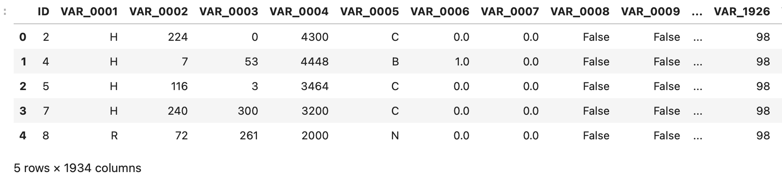
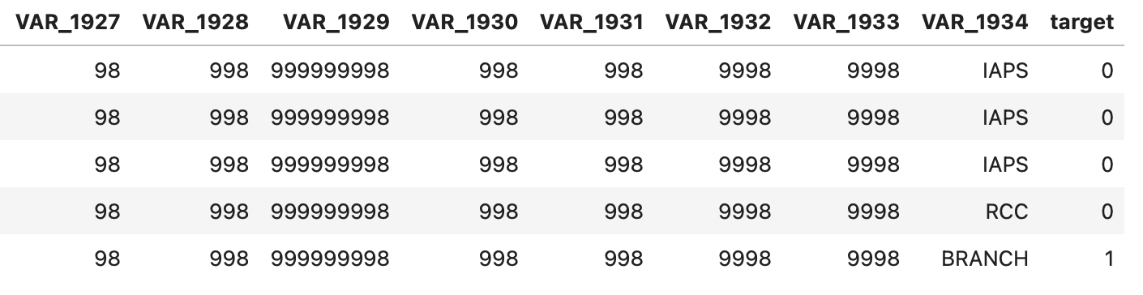
Why I Chose the Springleaf Marketing Response Problem
Large-scale real-world dataset (150k customers, ~2000 features) ideal for a full ML pipeline
High-dimensional, messy, anonymized data — excellent for demonstrating advanced preprocessing and feature engineering
A classic marketing problem with clear business value: predicting which customers respond to offers
Strong alignment with industry practice (banks, credit lenders, insurance companies use similar response models daily)
Opportunity to compare traditional ML, boosting models, and deep learning
Rich feature space enables meaningful model interpretation and business insight

Slide 7
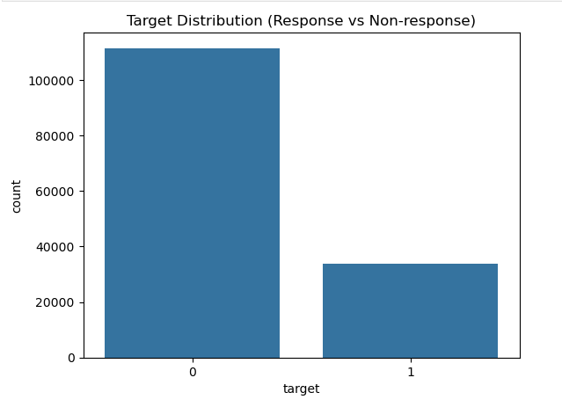
Problem Definition
Business Problem
We want to predict which customers are likely to respond to a marketing offer.
Helps optimize targeting, reduce campaign costs, and increase ROI.
Supports customer segmentation and smarter outreach strategies.
ML Problem
Binary classification: target = 1 (responder) vs 0 (non-responder).
High-dimensional tabular dataset (~1800+ features after cleaning).
Imbalanced classes → need AUC/PR-AUC instead of accuracy.

Slide 8
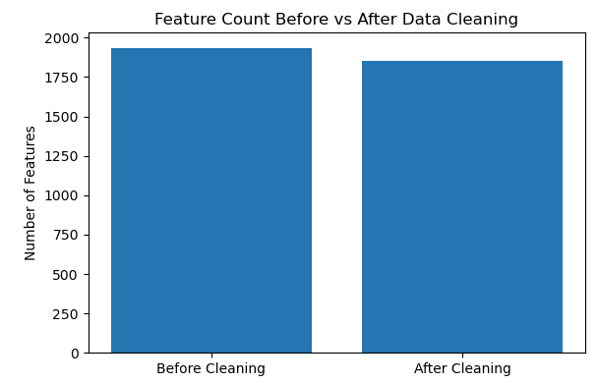
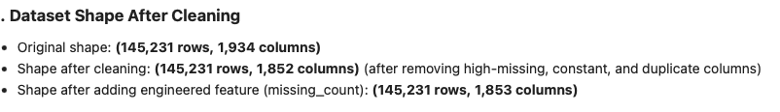
Dataset Description
Dataset Overview
Source: Kaggle — Springleaf Marketing Response Competition
Provider: Springleaf / OneMain Financial (US consumer finance company)
Type: Real-world marketing dataset for customer response prediction
Original Dataset Size (Raw)
Rows: 145,231 customers
Columns: 1,934 features
Contains:
Numeric, categorical, and timestamp-like variables
Many anonymized variables (e.g., VAR_0073, VAR_0127)
Heavy missingness and placeholder values (−1, 99, 99999, etc.)
Preprocessed Dataset Size (After Cleaning)
Final Columns: 1,853 features
Removed:
19 high-missing columns (>99% missing)
49 constant columns
14 duplicated columns
Target variable preserved: target (1 = responded, 0 = did not respond)

Slide 9
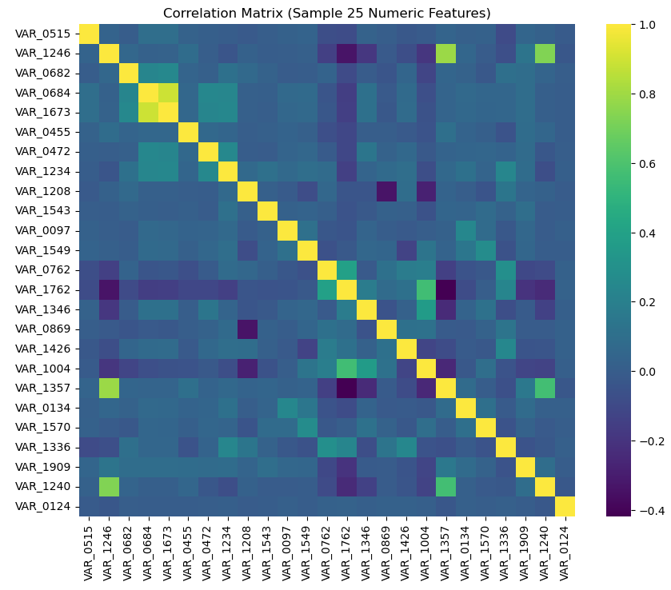
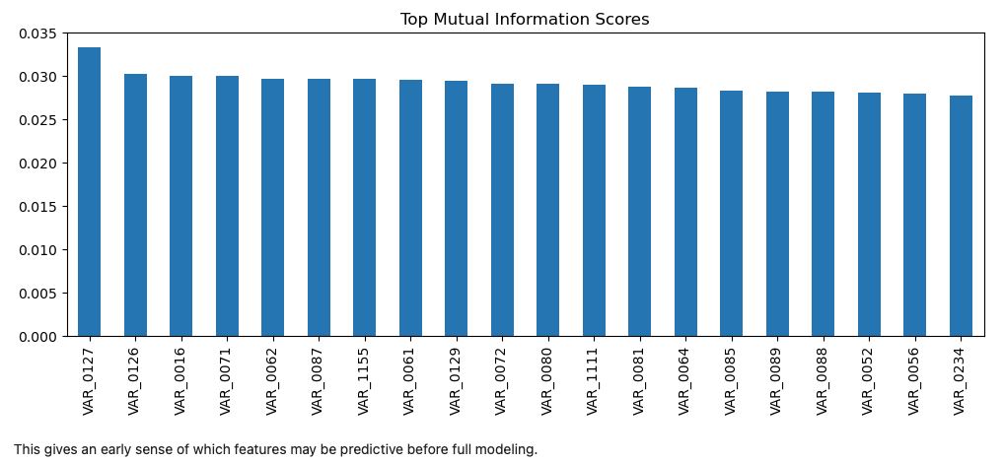
Key EDA Insights
1. Weak Linear Relationships
Correlation heatmap shows very low linear correlation across features.
Expected due to anonymized financial variables.
Indicates that simple linear models will perform poorly.
2. Non-Linear Predictive Signal
MI analysis reveals nonlinear relationships with the target.
Features with highest MI include:
Time-event variables (e.g., VAR_0073, VAR_0075 encodings)
Binary / discretized behavioral indicators
zero_count (overall “activity level”)
3. Interpretation for ML
Dataset contains useful signal, but hidden in nonlinear patterns.
Justifies using tree-based models (XGBoost, CatBoost) and nonlinear DL models.

Slide 10
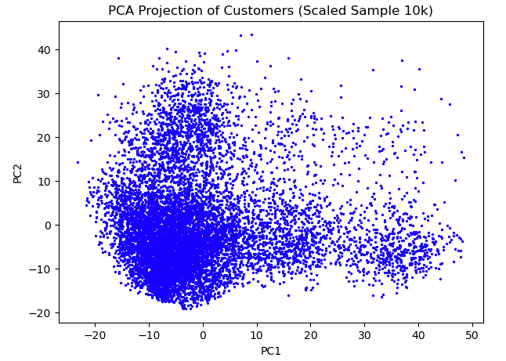
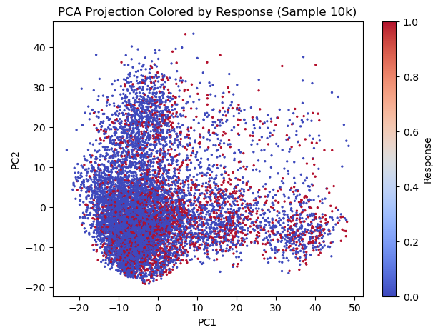
PCA Structure & Why Linear Models Fail
1. High-Dimensional Customer Space
PCA reduces ~1,800 numeric features into 2 components for visualization.
Customers form clusters and elongated shapes, indicating complex relationships.
2. Responders vs Non-Responders
When colored by response, responders (target=1):
Are more spread out across PCA space
Show subtle separation from non-responders
This means behavior patterns are non-linear and multi-dimensional.
3. Why Linear Models Underperform
Linear models assume straight-line boundaries.
PCA shows the data has curved, irregular separation, not straight lines.
Therefore: Tree-based models & Neural networks perform significantly better.

Slide 11
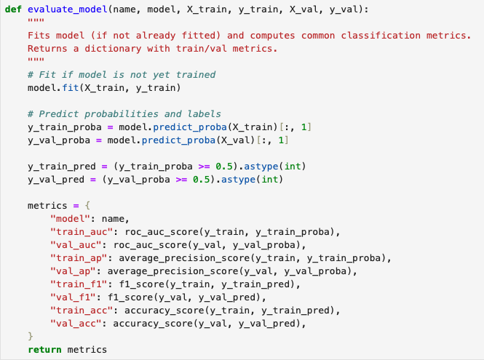
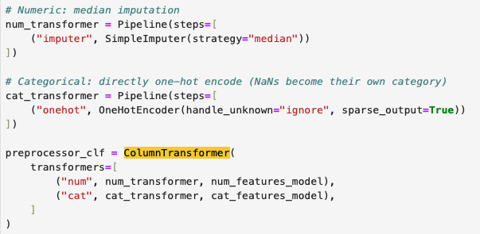
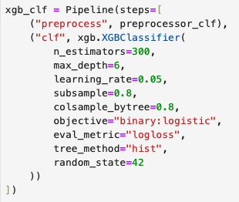
Modeling Approach Overview
Modeling goal: predict probability a customer responds to mail campaign.
Used train/validation split with stratification to preserve imbalance.
Built modular preprocessing pipeline:
Median imputation for numeric variables
One-hot encoding for categorical features
Created unified evaluate_model() to compute AUC, AP, F1, Accuracy.
All models share identical, consistent preprocessing → fair comparison.
Why This Approach
Reduces leakage
Ensures reproducibility
Makes tuning and stacking easier later

Slide 12
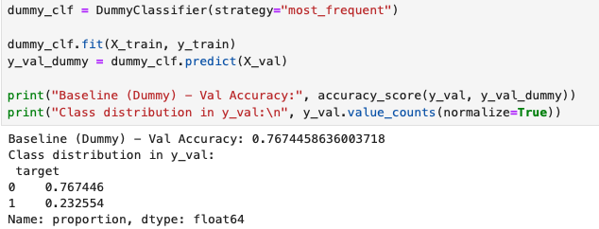
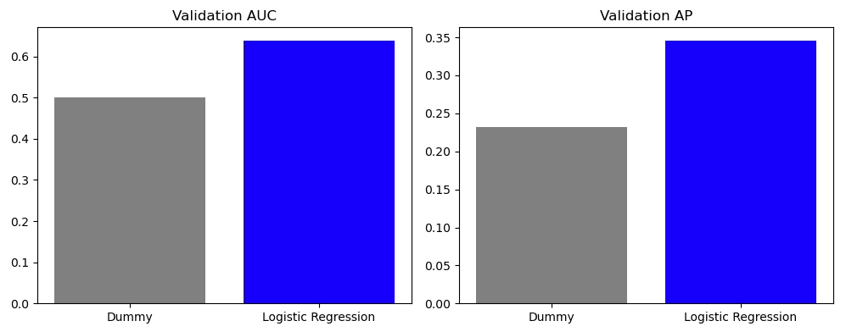
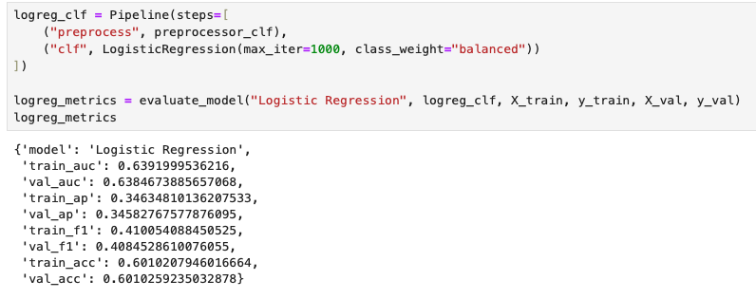
Baseline Models
Dummy Classifier: gives baseline from class imbalance (≈76% accuracy).
Logistic Regression:
Struggles with nonlinear + high-dimensional data
Achieves ~0.64 AUC → too low for useful marketing targeting
Key takeaway: Data is highly nonlinear & need more expressive models (trees, boosted models)
Why Important:
Shows why you need XGBoost/CatBoost/DL — sets the stage for advanced models.

Slide 13
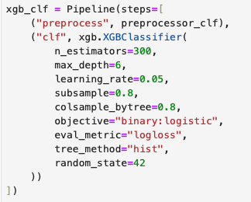
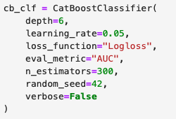
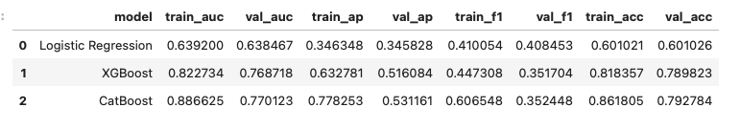
Advanced Models: XGBoost & CatBoost
XGBoost Baseline Code
XGBoost
Handles missing values natively
Learns nonlinear interactions
Strong baseline: ~0.768 AUC
CatBoost
Specialized for categorical variables
Slightly better on validation (~0.770 AUC)
Overfits more on training
Interpretation
Boosted trees extract patterns logistic regression cannot
Time-based and customer-segment categorical variables become key predictors
Why Important
Shows that simple models fail, while boosting captures real customer behavior.
CatBoost Model Code

Slide 14
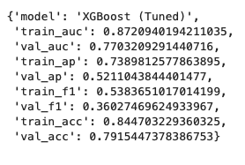
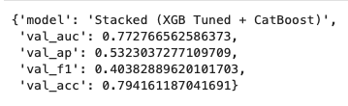
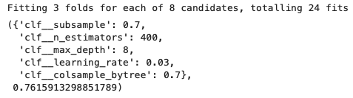
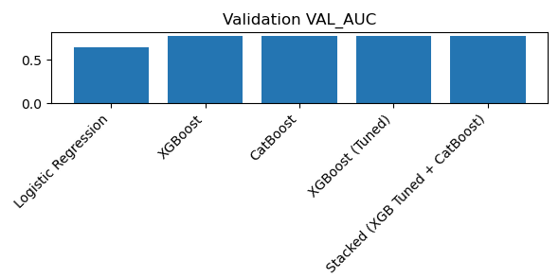
Hyperparameter Tuning + Stacking (Best Model)
1. Hyperparameter Tuning (XGBoost)
Tuned depth, learning rate, subsample, colsample
Slight improvement in AUC → better generalization
Reduced overfitting compared to baseline XGB
2. Stacking Ensemble
Combined tuned XGBoost + CatBoost
Meta-model: Logistic Regression
Achieved best validation AUC = 0.7728
Also best PR-AUC and strong F1
Why It Works
Stacking different model families (hist-based vs categorical-aware)
→ reduces errors where one model is weak.

Slide 15
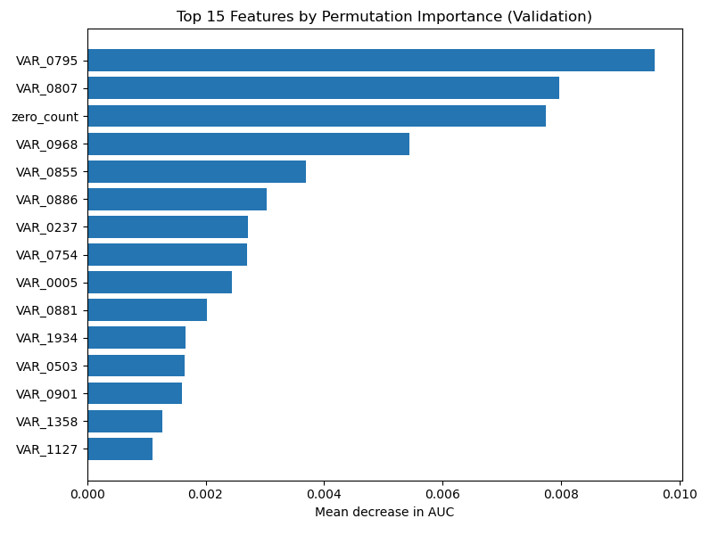
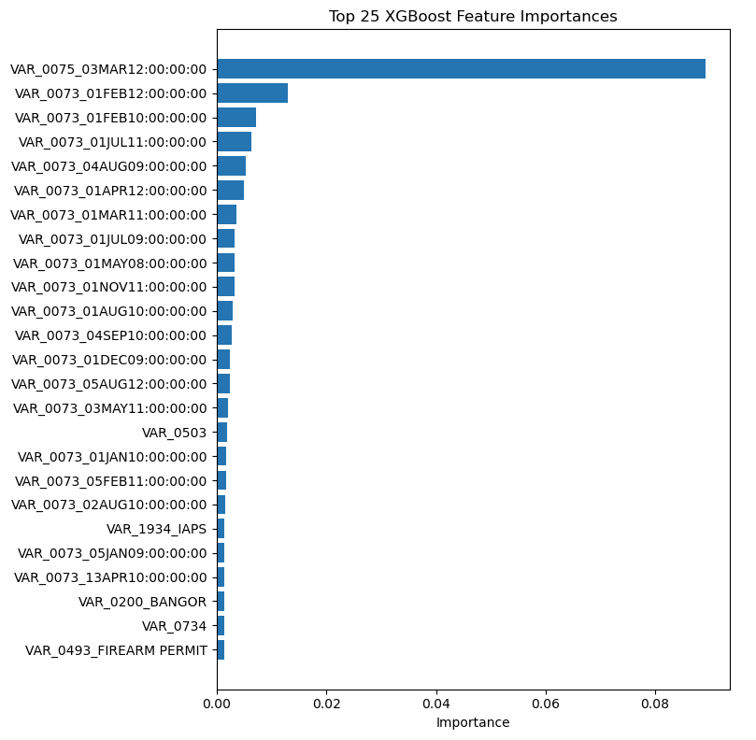
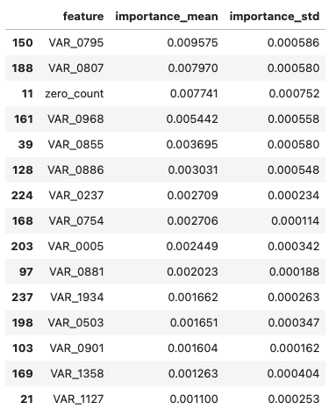
Model Interpretation
XGBoost importance highlights:
Time/event-based categorical features (VAR_0073, VAR_0075)
Customer segment codes (VAR_0001)
Location/occupation-like categories
Permutation importance validates these signals on validation set
SHAP couldn’t run due to XGBoost version parsing bug → documented
Findings:
Interaction timing is a driver of whether a customer responds
Customer profiles (segment/state/occupation) also influence response
Why Important
Demonstrates you can interpret models responsibly, even without real feature names.

Slide 16
Business Applications & Recommendations
How This Model Can Be Used
Targeted Direct Mail Campaigns
Prioritize customers with high predicted response probability → reduces wasted spend.
Personalized Offer Strategies
Use top predictive features (timing patterns & customer segments) to tailor message type, channel, and timing.
Budget Optimization
Allocate marketing budget toward high-ROI customer groups; reduce costs on low-response profiles.
Customer Segmentation Enhancement
Model uncovers hidden behavioral segments (e.g., event-timing signals, activity depth) for refined marketing strategies.
Campaign Performance Forecasting
Predict expected response rates before launching campaigns, improving planning accuracy.
Recommendations to the Business
Run tests with different campaign timing
Many top features relate to event timestamps — suggests certain periods drive higher engagement.
Develop targeted customer journeys
Focus on customer groups identified by the model (e.g., specific segment codes or occupation clusters).
Combine model with marketing rules
Use model scores alongside business constraints (loan type, location, contact policies) for smarter targeting.
Periodically retrain the model
Customer behavior shifts over time; regular retraining ensures stable accuracy.
Integrate into CRM automation
Use high-scoring leads to trigger personalized outreach (email, SMS, phone).

Slide 17

Thank you!

